Slide 1
Introduction to MRI
27 June 2016

Slide 2
Basis of All MRI – Magnetic Properties of Protons
Protons spin and have angular momentum
This also gives them a magnetic moment
Think of brain as bulk matter with anisotropic distribution of magnetic moments (from H₂0 atoms)
+
N
S
A moving charge creates a current, a current creates a magnetic field (and vice versa)

Slide 3
Why Do We Need a Big Magnet?
Protons spin and have angular momentum
This also gives them a magnetic moment
An externally applied magnetic field will
align the net magnetic moment in it’s own direction.
+
N
B
o
M_{o}
S
A moving charge creates a current, a current creates a magnetic field (and vice versa)

Slide 4
Generating Images – Stuff Happens!
B
o
To generate an image, we excite protons with an RF pulse (magnetic field B₁) orthogonal to B₀
Magnetization protons precesses about B₀ at a frequency proportional to the strength of B₀
This creates a voltage in a receiver coil placed close to the head
Gradients used to alter both frequency and phase of spinning protons, which allows us to localize (i.e., identify where) each of the protons are located => Make pictures!
B
1
Larmor Frequency

Slide 5
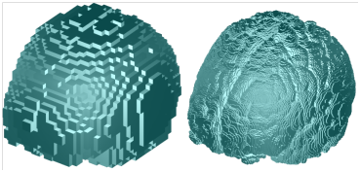
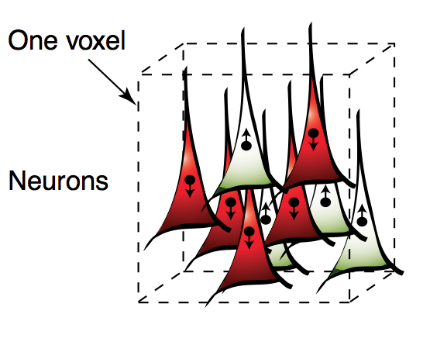
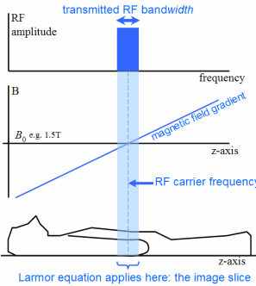
What is a voxel?
In 2D MRI we make a single slice at a time
For axial slices we apply a gradient along z-axis when we turn on the RF pulse
Each slice is broken down into lots of voxels (volume elements) where x, y coordinate corresponds to a unique frequency & phase of relaxation (due to additional gradients)

Slide 6
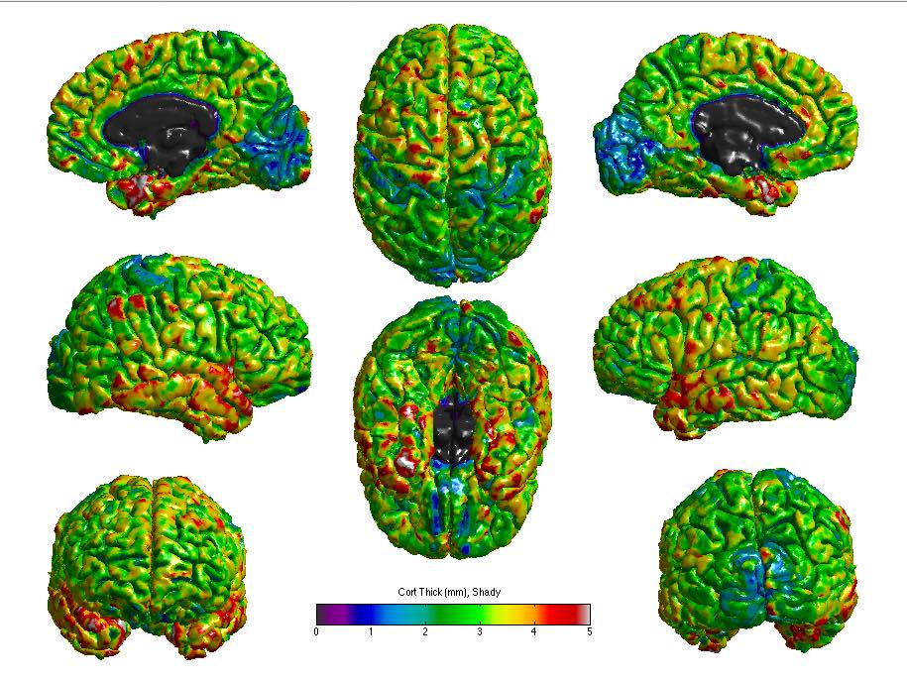
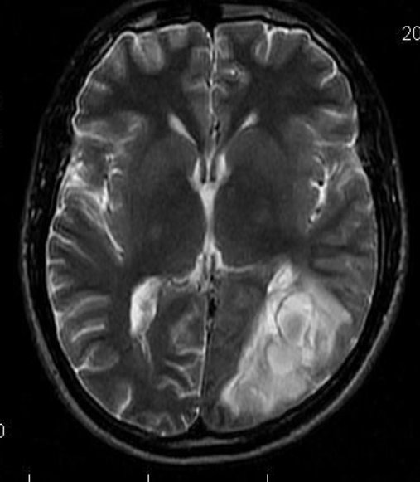
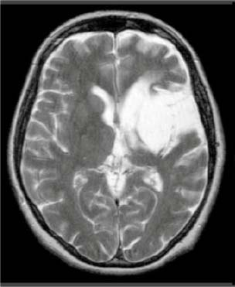
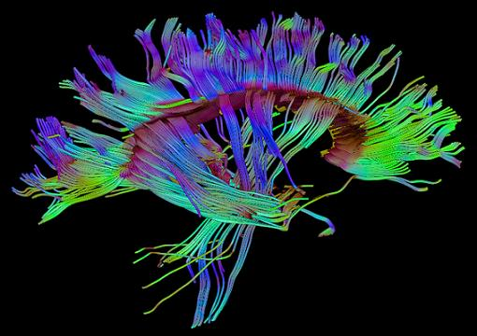
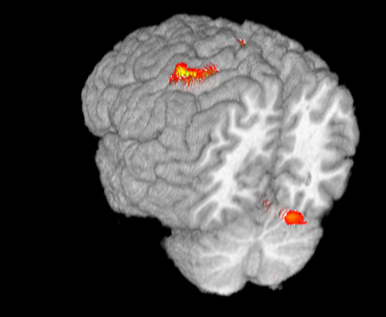
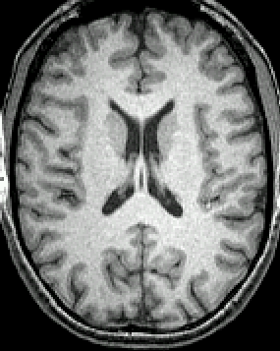
MRI – Powerful Because So Many Contrasts
DTI
T2
PD
BOLD fMRI
Cortical Thickness
T1

Slide 7
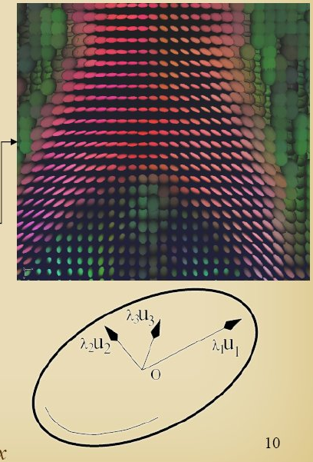
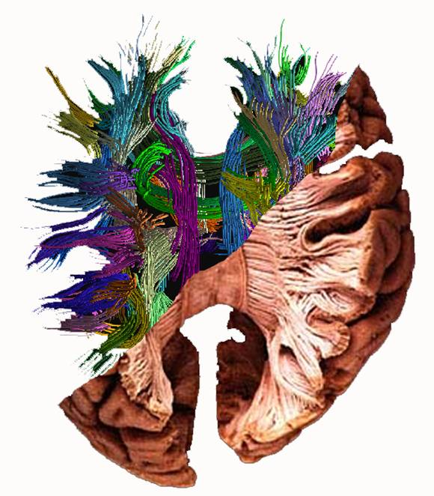
Diffusion Tensor Imaging (DTI)
Measures mobility of water
Water inside an axon is very limited in directions it can move
DTI essentially measures that limited mobility
www.greyc.ensicaen.fr

Slide 8
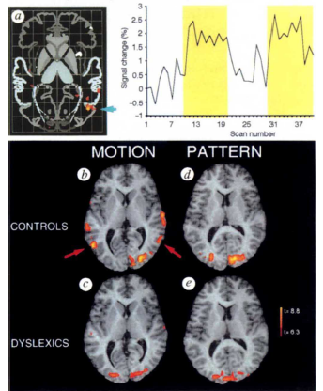
BOLD fMRI
Uses magnetic properties of blood to infer neuronal activity
Thus – it is not a direct measure of neuronal activity
Very useful for non-invasively measuring activity with relatively high spatial resolution and fairly high temporal resolution
Eden, VanMeter et al., 1996

Slide 9
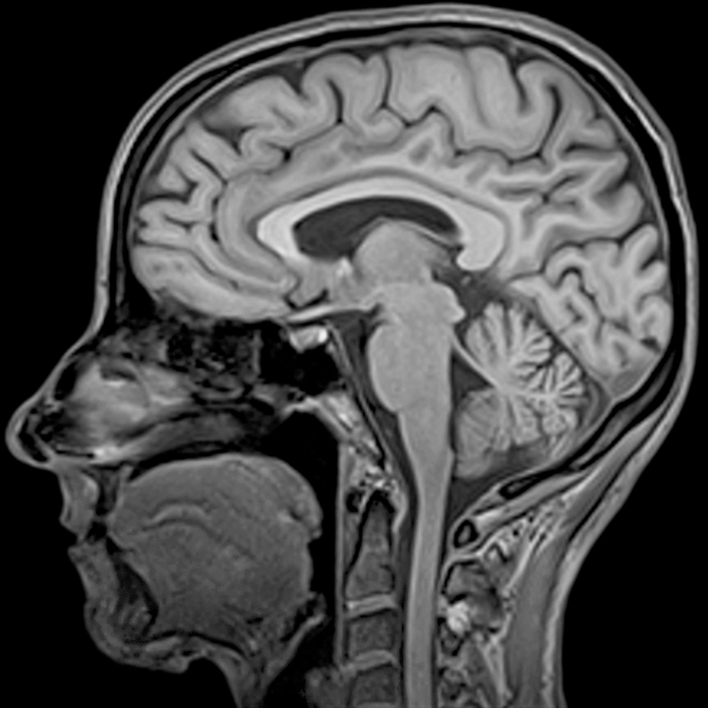
MPRAGE – Main Type of Image Used in FreeSurfer
Magnetization Prepared Rapid Gradient Echo
Provides great contrast between gray and white matter (T1-weighted)
Unfortunately, parts pial surface have about the same intensity as gray matter
This confuses FreeSurfer!!
Notes:
Magnetization Prepared Rapid Gradient Echo pulse sequence

Slide 10
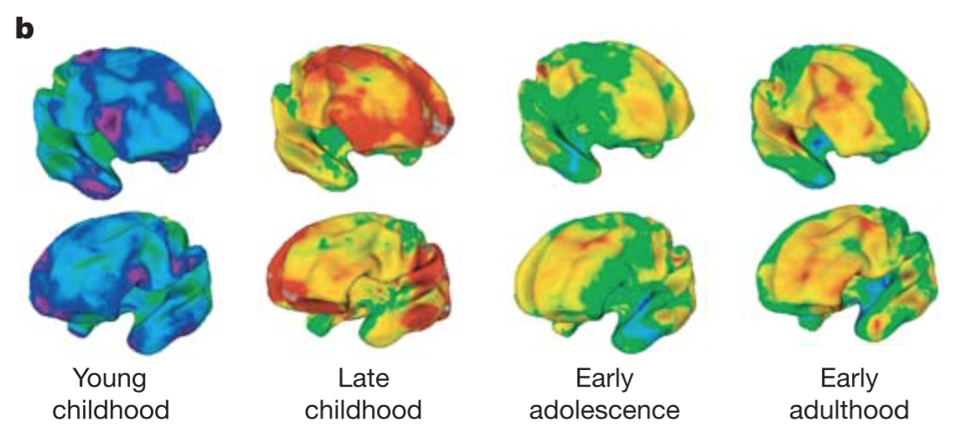
Cortical Thickness – Changes with Age
Shaw et al. 2006

Slide 11
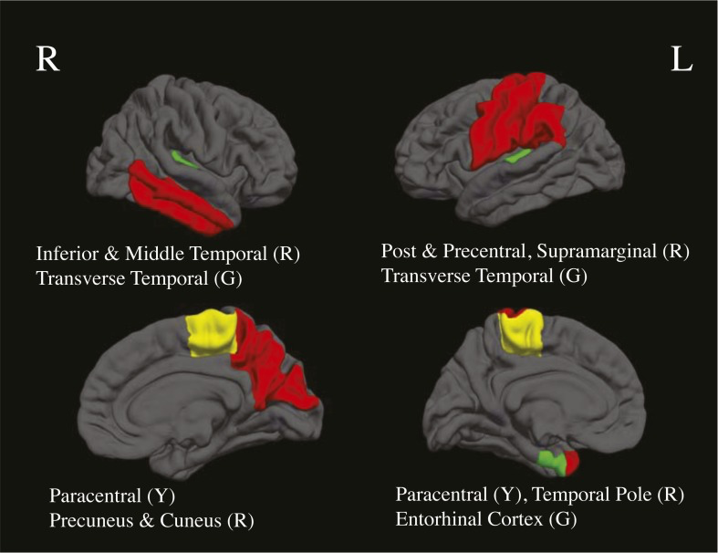
Cortical Thickness in MJ & Alcohol Users
MJ, Alcohol compared to non-users
Mean age 17.4 yo
Reduced thickness in Alcohol users (red)
Reduced thickness in MJ users (green)
Reduced in both users (yellow)
Jacobus et al. 2014

Slide 12
Introduction to Adolescent Development Study (ADS)
27 June 2016

Slide 13
Aims/Goals of the Adolescent Development Study (ADS)
Aim 1: Identify neurodevelopmental factors that predict the initiation/escalation of substance use
Aim 2: Developmental Impact of Substance Use
Expanded to also examine:
Genetics and epigenetics
Environmental factors: dietary factors (omega3 fatty acids and iron) and alcohol related advertising

Slide 14
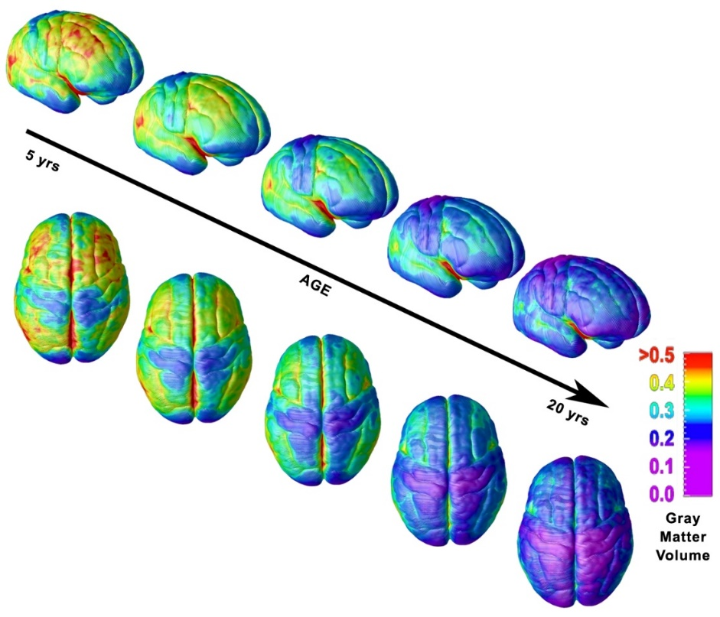
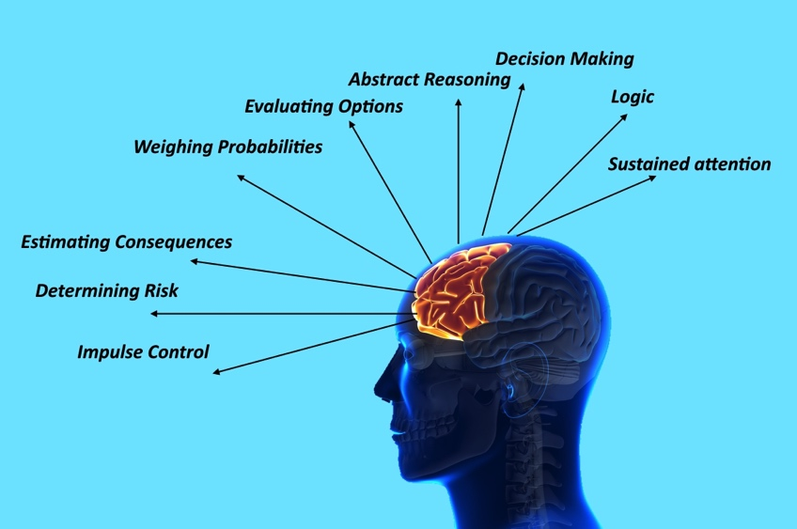
Frontal Cortex is Last to Develop
Gogtay et al., 2004
Notes:
Planning, decision-making, impulse control, memory, language, processing social cues
Continued myelination of cortical regions for faster communication through the teen years and early twenties
Pruning of excess connections established earlier in development
New connections established: enhanced integration between brain areas

Slide 15
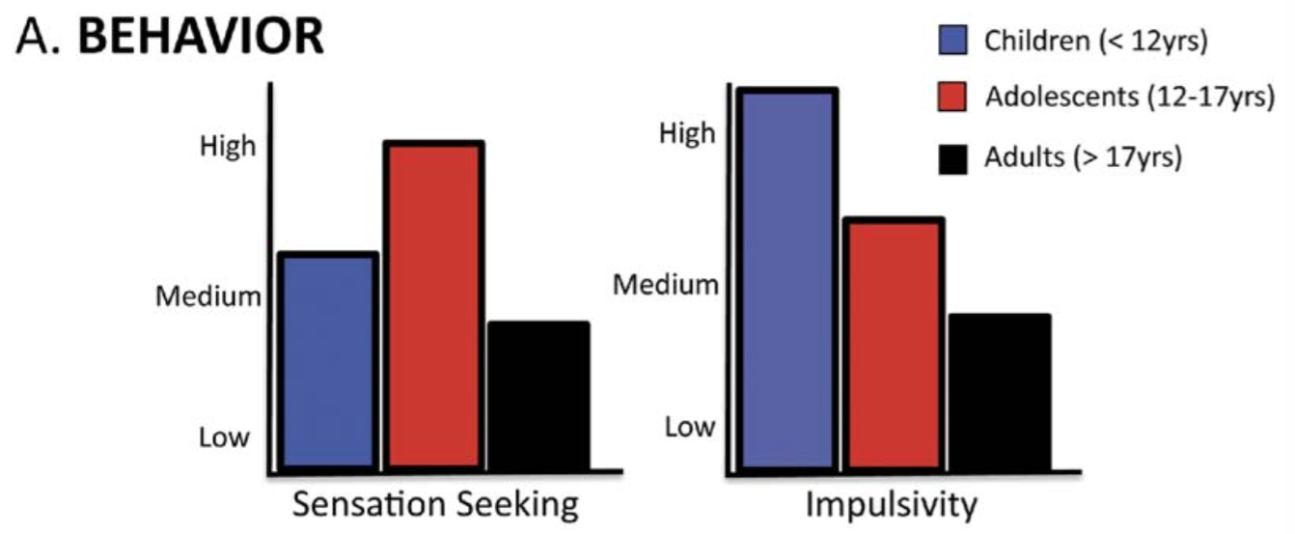
Behavioral Consequences
Casey & Jones 2007

Slide 16
Dual Systems Model of Adolescent Development
Reward Sensitivity
Inverted U shaped trajectory
Largely due to asynchronous PFC/NAcc development
Ability of PFC to regulate ventral striatum
Inhibitory Control
Linear improvements
Largely due to PFC development
Development
Behavioral Phenotype:
Risk taking
Novelty seeking
Impulsive
→ Risk →
Harm from:
Accidents
Violence
STDs
Drugs/Alcohol
Adolescence
Casey et al. 2008; Steinberg 2008; Hardin & Ernst 2009.
Age
Notes:
Schematic representation of the developmental trajectories of reward sensitivity and inhibitory contro
AGE x axis
BEGAN OUR STORY WITH
NEXT PIECE was subcortical
The combination of hypersensitivity to reward (Rew) and still immature inhibitory control (IC) yield a typical adolescent behavioral profile that includes increased risk-taking, novelty- seeking, and impulsivity.
leads to increased risk for adolescents, as these behaviors increase the likelihood that adolescents will experiment with substances.
CLICK A few moving parts to theis model I could talk about but for the rest of todays talk, focus on INHIB CONROL

Slide 17
ADS Study Design
Wave1 Wave2 Wave3
N: 135 111 ~105
Age: 11.0-13.0 yo 12.5-14.5 yo 14.0-16.0 yo
Users: 0 19 32
Adolescent Measures (~6 hrs)
MRI Structural & Functional (~1.5 hrs)
DTI MRI (white matter integrity)
fMRI – Continuous Performance Task
fMRI – Wheel of Fortune Task
fMRI – Emotional Counting Stroop
fMRI – Resting State
High resolution structural (cortical thickness, volume)
Outside scanner (~4.5 hrs)
Temporal Discounting, Facial Emotion recognition Task
KBIT, Trail Making, Spatial WM, Stockings of Cambridge
DUSI (Drug Use Survey Instrument)
Diet assessment (relative DHA intake)
Alcohol advertising exposure
Parent Measures (~2 hrs)
Demographics, factors related to Social Economic Status (SES)
AUDIT (self report of alcohol use)
Family History of Drug/Alcohol Use
Perinatal questionnaire
BRIEF (parent report of child’s executive function and impulsivity)
ADHD Rating Scale (parent rating of child)
Temperament Scale (parent rating of child)

Slide 18
ADS Sample Characteristics
Sample of 142 adolescents very representative of the racial and SES makeup of the D.C. metro region
Wave 2 116 completed (~82%)
Wave 3 108 completed (last ones tested this past weekend!)
N | 135 (73F,62M)
Age | 12.7(0.8)
Pubertal status | 2.2(0.70)
Race and Ethnicity
African American | 45 (33%)
Caucasian | 70 (51.9%)
Hispanic/Latino | 9 (6.7%)
Other | 11 (8.1%)
Socioeconomic Status
Parent cumulative years education, mean | 16.2(2.9)
Household income Mean Median | $50,000 -$74,999 $100,000-$149,000
IQ (KBIT) | 108.8(15.3)
Alcohol Risk distribution (from DUSI-QS)
Low (%) | 116 (85.9%)
Medium (%) | 8 (5.9%)
High (%) | 11 (8.1%)
Notes:
Median incomes: DC $52K, MD $70K, VA $62K
Race/Ethnicity:
DC: 51% African-American, 40% Caucasian, 10% Hispanic
VA: 20% African-American, 71% Caucasian, 9% Hispanic
MD: 30% African-American, 61% Caucasian, 9% Hispanic

Slide 19
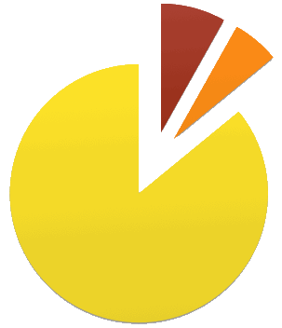
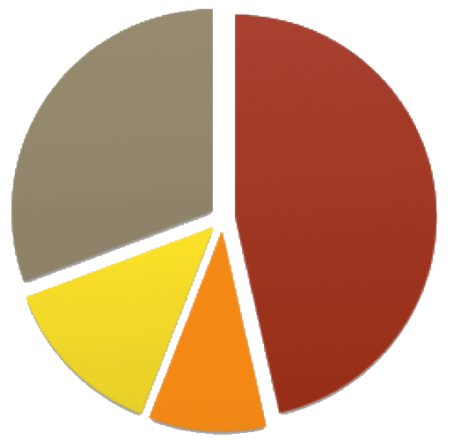
ADS Sample by Risk
DUSI-QS*
Family History
(*73% predictive of SUD by age 22)
High Risk = 8.1%
Med. Risk = 5.9%
No FH = 30.7%
Alcohol = 46.5%
Alcohol + Drug
= 13.4%
Low Risk = 86%
Drug
= 9.4%

Slide 20
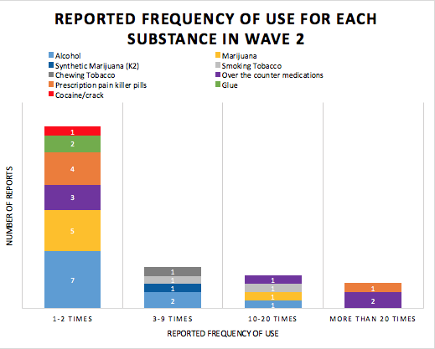
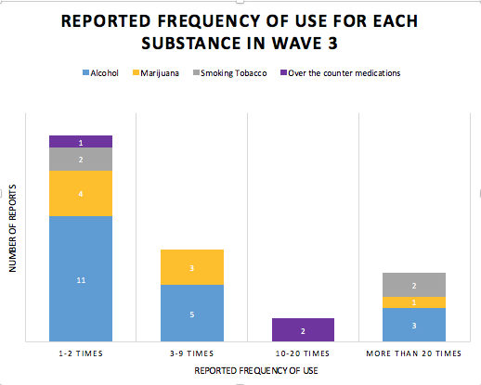
Frequency of Use by Substance
Wave 2 Wave 3
* Based on DUSI

Slide 21
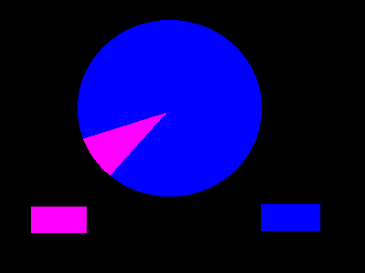
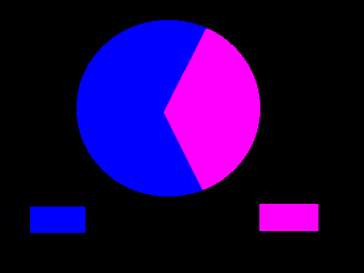
Wheel of Fortune (Gambling Task) fMRI
10% vs 90% trials 30% vs 70% trials
$7.00
$18.00
$2.00
$9.00
$21.00
$9.00
$1.00
$3.00
Notes:
Should extend this slide or add another to show the trial structure Selection 3s; Delay 3s; Fe

Slide 22
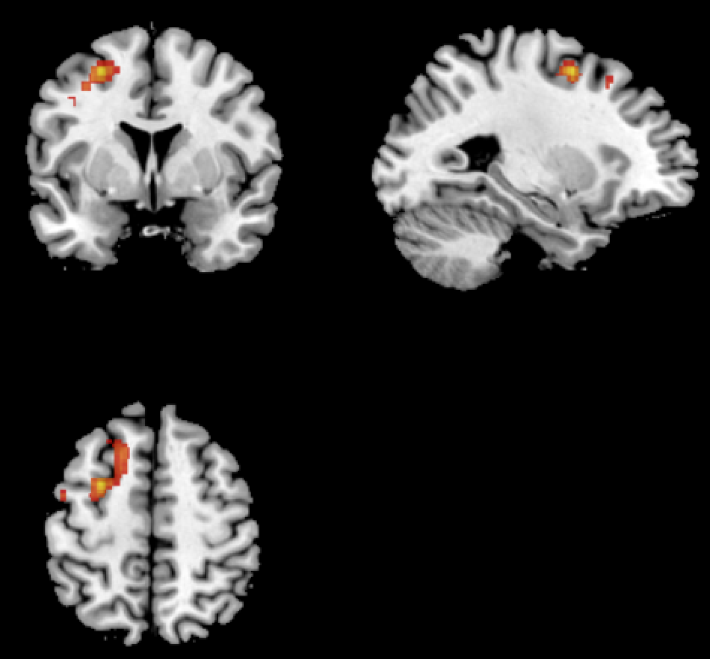
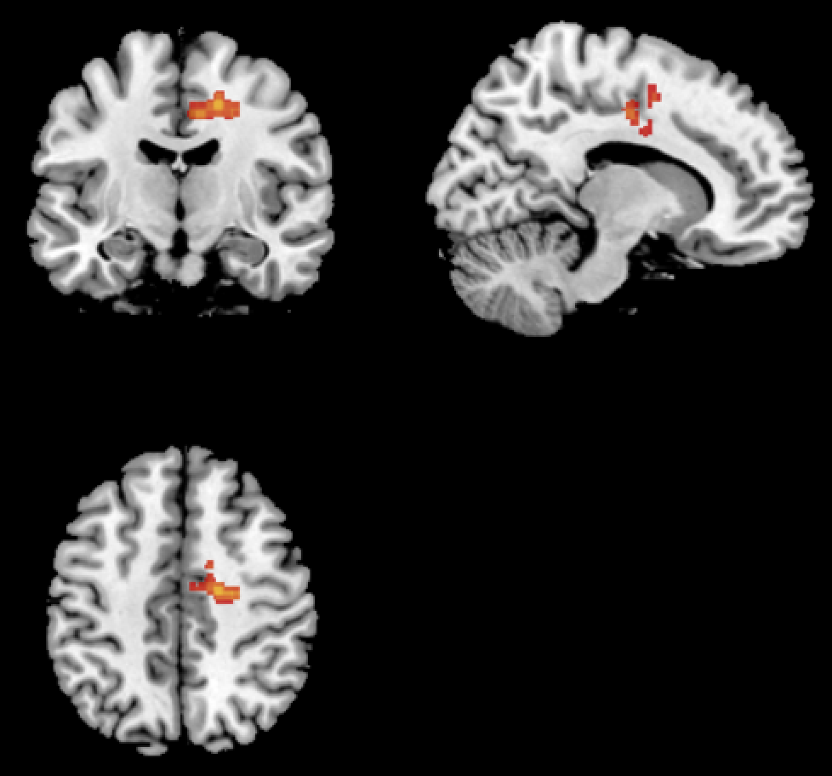
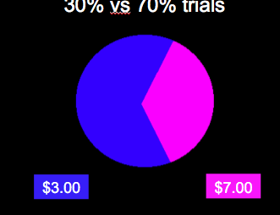
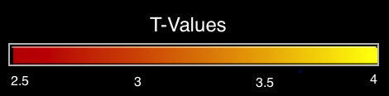
Wheel of Fortune (Gambling Task) Non-Users > Users
Contrast: High Reward (Low Probability) > Low Reward (High Probability)
>
Left Superior/Middle Frontal Gyri Right Mid-Cingulate
p < 0.05 Cluster Corrected
Notes:
R Mid-cingulate: Gruber & Yurgelun-Todd 2005 – MJ users less activity on a stroop task
L Superior/Middle Frontal Gyri: Bjork et al. 2007 – Adults > adolescents for risky decision making

Slide 23
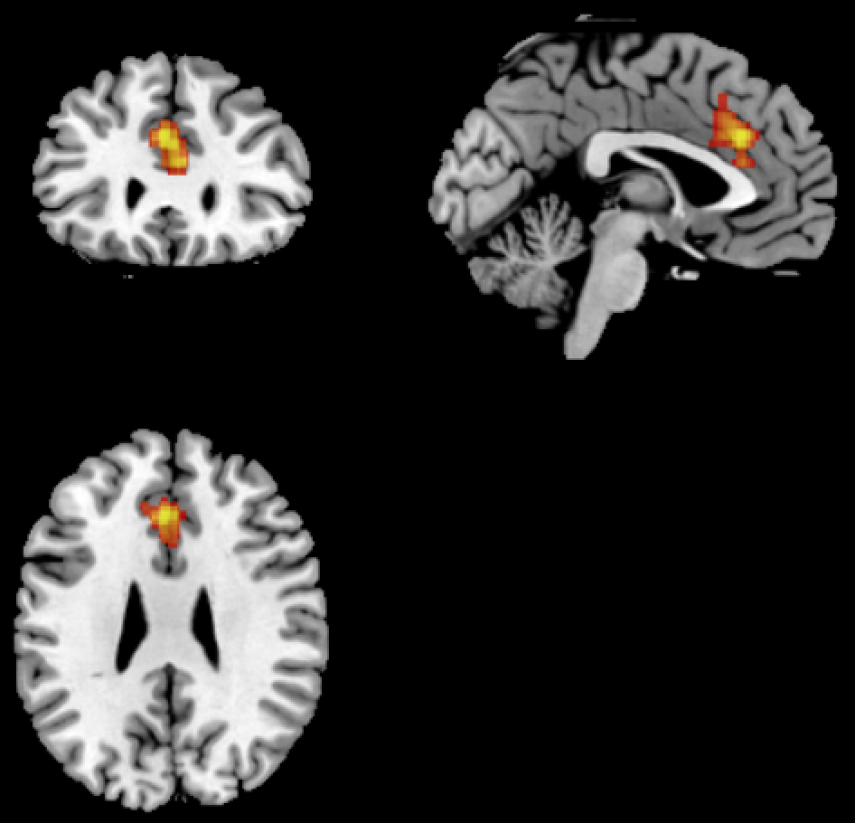
Wheel of Fortune (Gambling Task) Non-Users > Users
Contrast: Wins > Loses
You won $9!!
Total: $40
>
You lost $1
Total: $30
Dorsal-Anterior Cingulate
p < 0.05 Cluster Corrected
Notes:
Forbes et al. 2014 – less activity in FH+ adults & alcohol dependent young adults for reward

Slide 24
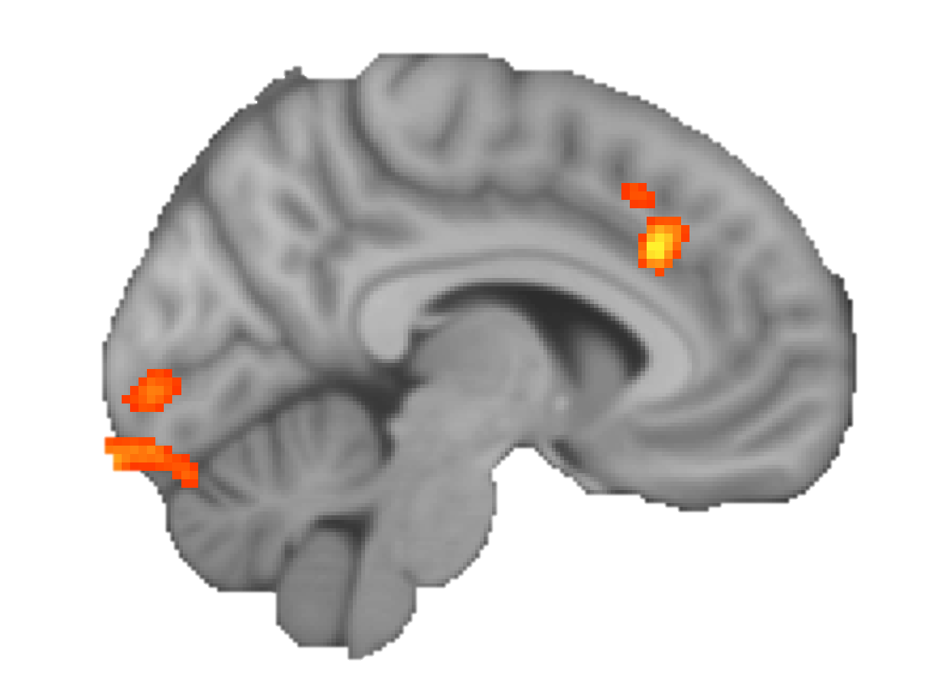
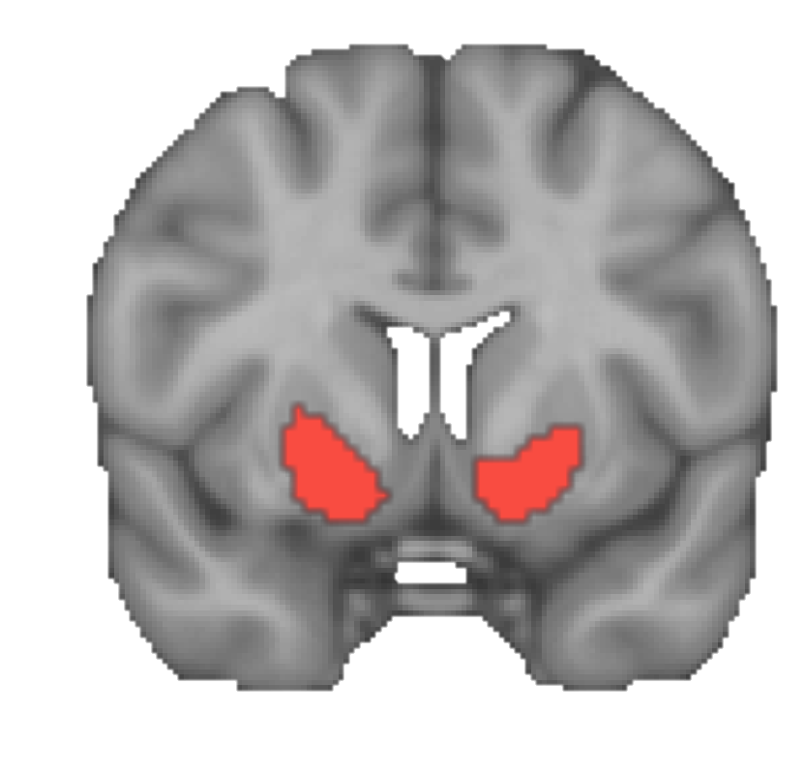
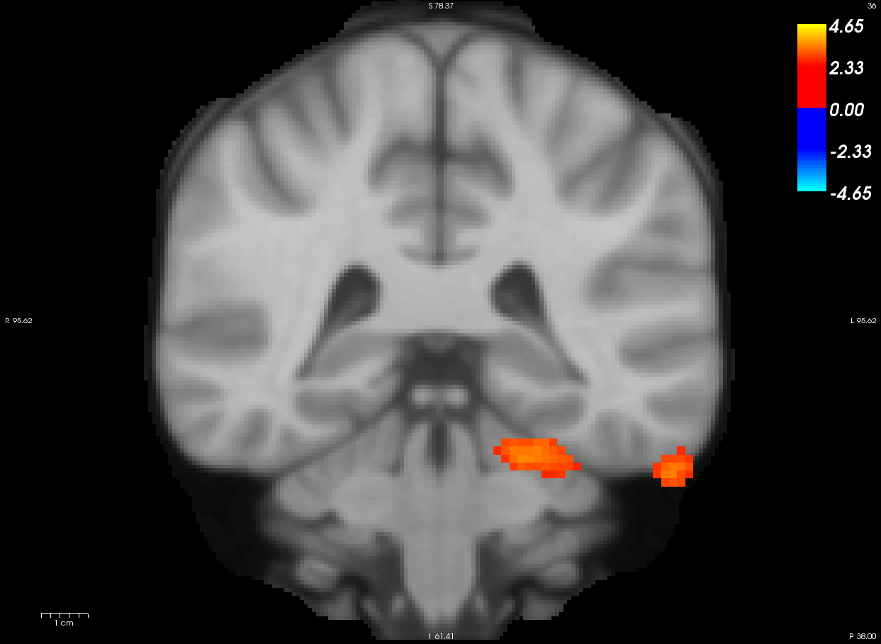
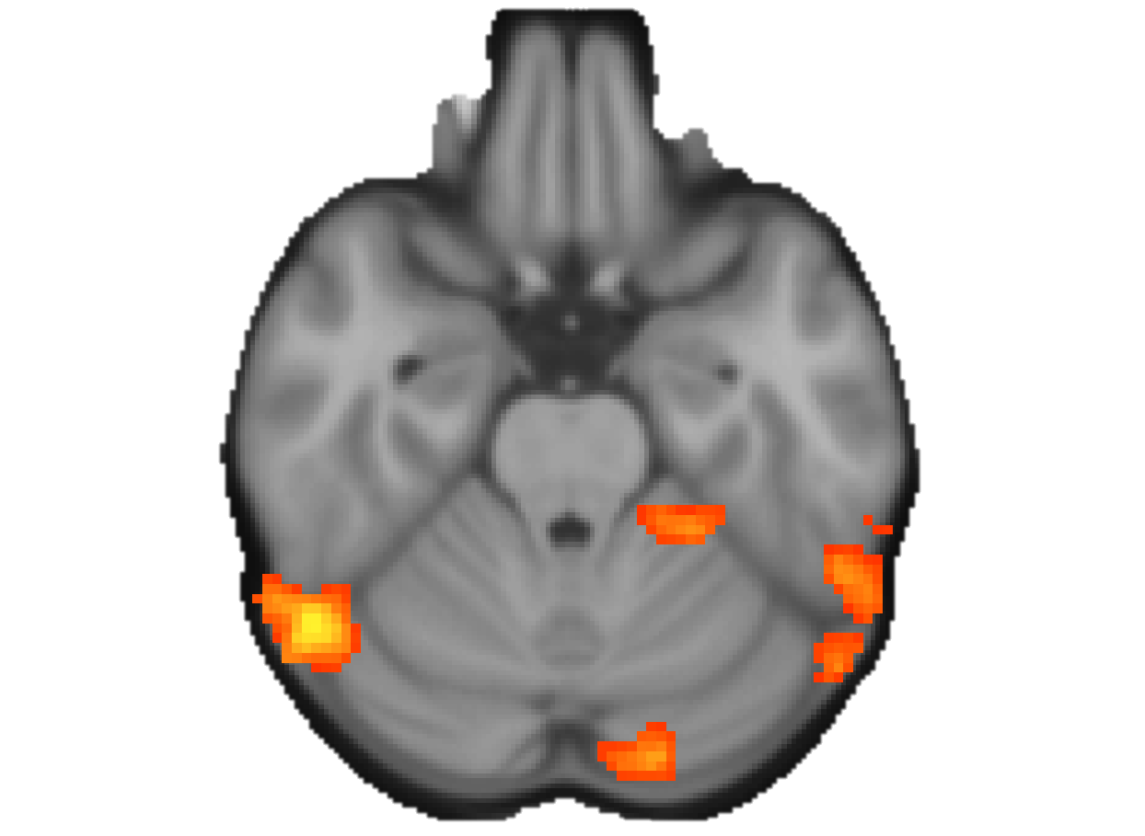
Striatal-Cortical Resting-State Connectivity
Non-Users > Users
Ventral
Striatum
Paracingulate
R Occipital/Fusiform
pFDR < 0.05
Notes:
cluster position: MNI coordinates of largest peak within this cluster
cluster size: number of voxels in this cluster
cluster p-FWE: family-wise error corrected p-value (probability under the null hypothesis of observing one or more clusters of at least this size across the entire brain)
cluster p-FDR: false discovery rate corrected p-value (expected proportion under the null hypothesis of false discoveries among clusters of at least this size)
cluster p-unc: uncorrected p-value (probability under the null hypothesis of a randomly-selected cluster having at least this size)
peak p-FWE: family-wise error corrected p-value (probability under the null hypothesis of observing one or more peaks of at least this height across the entire brain)
peak p-unc: uncorrected p-value (probability under the null hypothesis of a randomly-selected peak having at least this height)

Slide 25
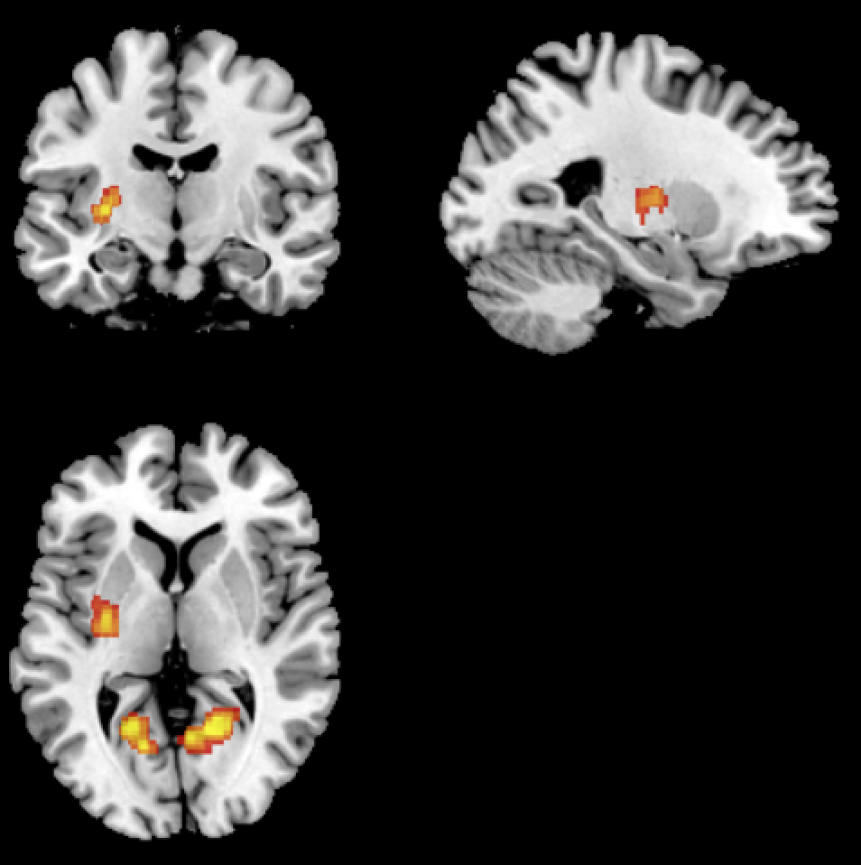
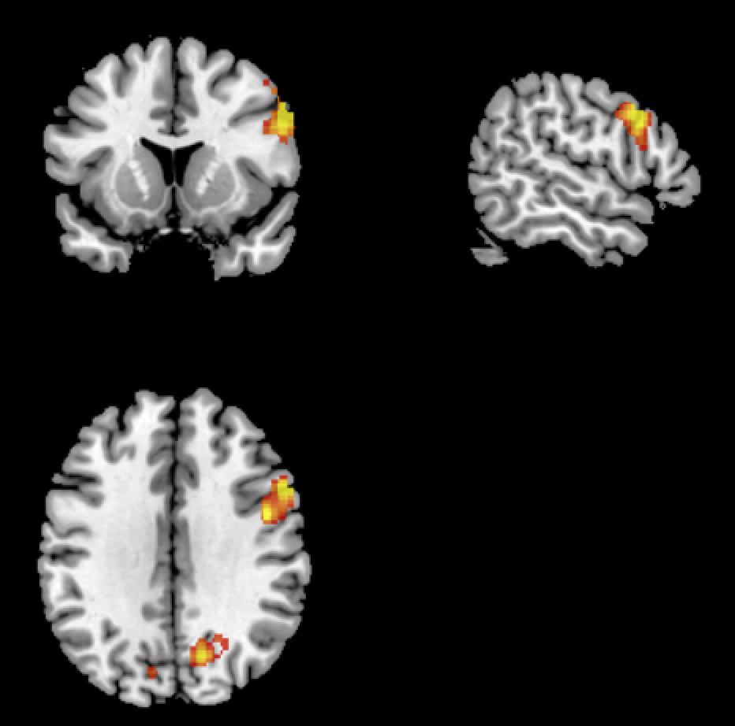
Wheel of Fortune (Gambling Task) GABA α2 (rs279826) Risk Genotype: High risk for AUD (G/G) > Low Risk (A/A and A/G)
Contrast: Wins > Loses
>
You won $9!!
Total: $40
You lost $1
Total: $30
Left Striatum Right Inferior Frontal Gyrus
Right & Left Inferior Parietal Lobe
p < 0.05 Cluster Corrected
Notes:
α2 subunit of the GABA-A receptor has multiple SNPs associated with risk for AUDs
Most consistently found is the G allele of the rs279826 SNP
rs279826 also associate with impulsivity in adults and externalizing behaviors in adolescents
Developmental change found in non-human primates such that α2 subunit expression decreases during adolescence to reach the adult levels
Analyses examine both gene expression (G/G vs A/A or A/G) and development (Wave1 vs Wave2)

Slide 26
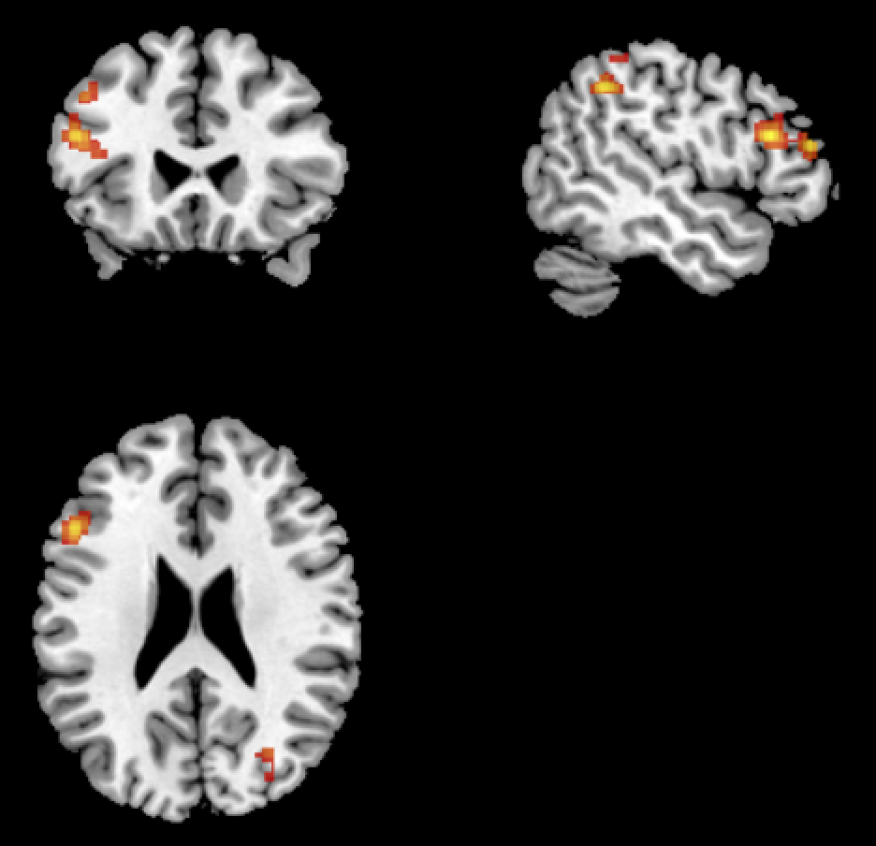
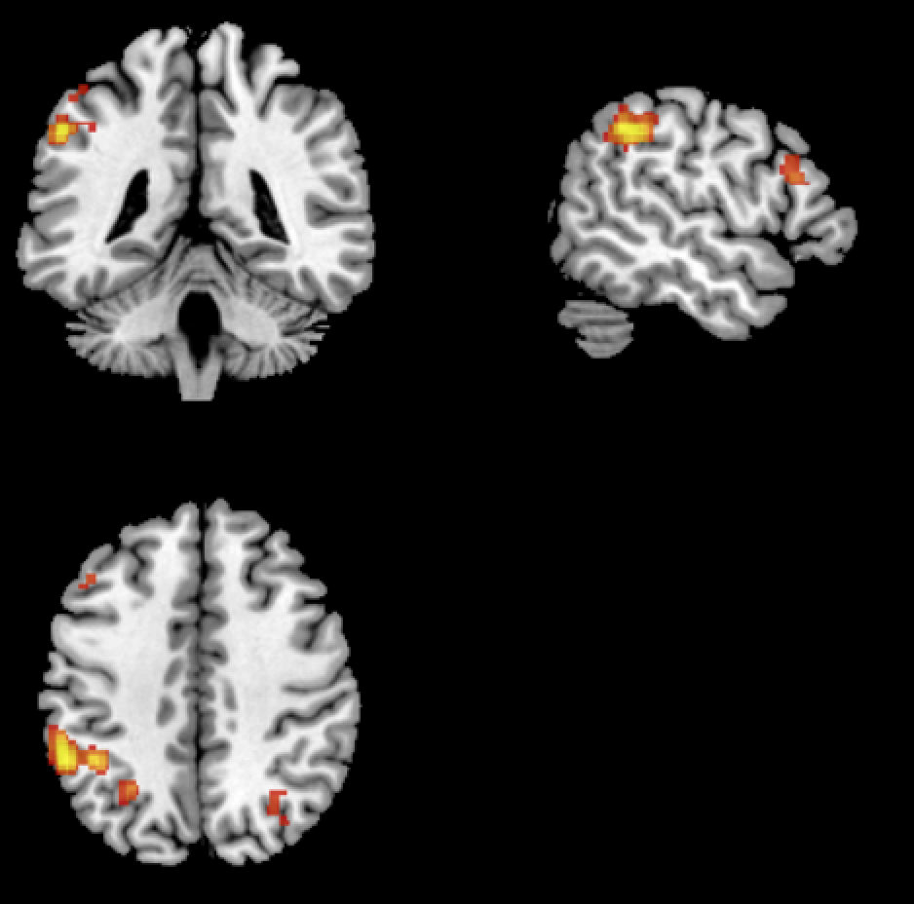
Wheel of Fortune (Gambling Task) Main Effect of DRD2 (rs6277) Risk Genotype: Low Risk (T/T and T/C) > High Risk (C/C)
Contrast: Wins > Loses
>
You won $9!!
Total: $40
You lost $1
Total: $30
Left Middle/Inferior Frontal Gyrus Right & Left Inferior Parietal Lobe
p < 0.05 Cluster Corrected

